Slide 1

Taming the Wild West
of LLMs
Nazneen Rajani | Research Lead @ Hugging Face | nazneen@hf.co | @nazneenrajani
Notes:
Thanks for the kind introduction and thanks for inviting me.
The title of my talk is “The Wild West of NLP Modeling, Evaluation, and Documentation”.

Slide 2












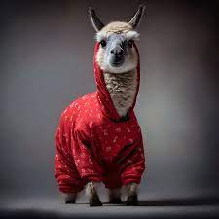
Text-to-Text Foundation Models since GPT3
GPT-3
GPT-Neo
Megatron TNLG
Cohere
GPT-NeoX
PaLM
OPT
Flan-T5
Galactica
Flan-UL2
StarCoder
Falcon
Jul
Dec
Jul
Dec
Feb
Jun
Oct
Feb
Oct
Nov
Jun
2021
2022
Apr
May
2023
March
May
GPT-J
Jurassic
Gopher
Anthropic
Chinchilla
UL2
ChatGPT
LLaMA
GPT-4
INCITE
LLaMA-2
BLOOM
*only LLMs with >1B parameters & EN as the main training language are shown. Comprehensive list: https://crfm.stanford.edu/helm/v1.0/?models=1
Notes:
This slide shows a timeline of all the text-based large language models released since GPT3
This does not include the multiple versions and sizes of each of these models.
It only covers models that are predominantly trained on the english language.

Slide 3


Text-to-Text Foundation Models since GPT3
GPT-3
GPT-Neo
Megatron TNLG
Cohere
GPT-NeoX
PaLM
OPT
Flan-T5
Galactica
Flan-UL2
StarCoder
Falcon
Jul
Dec
Jul
Dec
Feb
Jun
Oct
Feb
Oct
Nov
Jun
2021
2022
Apr
May
2023
March
May
GPT-J
Jurassic
Gopher
Anthropic
Chinchilla
UL2
ChatGPT
LLaMA
GPT-4
INCITE
LLaMA-2
BLOOM
*only LLMs with >1B parameters & EN as the main training language are shown. Comprehensive list: https://crfm.stanford.edu/helm/v1.0/?models=1
Notes:
This slide shows a timeline of all the text-based large language models released since GPT3
This does not include the multiple versions and sizes of each of these models.
It only covers models that are predominantly trained on the english language.

Slide 4
Model Access
🔓
🔐
🔒
Open access
Limited access
Closed access
Notes:
Limited access falls somewhere in between open and closed. The access can be via API or through a review process of call for research proposals and then granting approved proposals limited model access.

Slide 5
🔓 Open Access Models
Model components are publicly available:
Open source code
Training data
Sources and their distribution
Data preprocessing and curation steps
Model weights
Paper or blog summarizing
Architecture and training details
Evaluation results
Adaptation to the model
Safety filters
Training with human feedback
Notes:
Open access models have all their components publicly available.
This includes the source code
Training data including the sources and their distribution, Data preprocessing and curation steps
Paper or blog summarizing the training details, evaluation, and any adaptations to the model such as safety filters and if it was trained with human feedback.

Slide 6
🔓 Open Access Models
Allows reproducing results and replicating parts of the model
Enable auditing and conducting risk analysis
Serves as a research artifact
Enables interpreting model output
Notes:
Open access models allow replicating and reproducing the model
They enable researchers to audit and conduct risk analysis
Serves as a research artifact for ML practitioners to study, draw conclusions from, and build off of
It also enables practitioners to attempt to interpret model outputs.

Slide 7
🔒 Closed Access Models
Only research paper or blog is available and may include overview of
Training data
Architecture and training details (including infrastructure)
Evaluation results
Adaptation to the model
Safety filters
Training with human feedback
Notes:
OTOH closed access models usually just have a paper or blog and may include high level overview of
Data
Architecture and training details
Evaluations results
Adaptations to the model

Slide 8
🔒 Closed Access Models
Safety concerns
Competitive advantage
Expensive to setup guardrails for safe access
Notes:
There could be one or more reasons for keeping these very large models closed
There are concerns about their misuse
It gives the model creators a competitive advantage to not release these models
Even if they would like to give access for research purposes and other studies, it can be expensive to setup guardrails for safe access
Some model creators have managed to get that setup in what we can call a limited access

Slide 9
🔐 Limited Access Models
Available for use via:
API
Call for research proposals
Notes:
There could be one or more reasons for keeping these very large models closed
There are concerns about their misuse
It gives the model creators a competitive advantage to not release these models
Even if they would like to give access for research purposes and other studies, it can be expensive to setup guardrails for safe access
Some model creators have managed to get that setup in what we can call a limited access

Slide 10
Text-to-Text Foundation Models since GPT3
GPT-3
GPT-Neo
Megatron TNLG
Cohere
GPT-NeoX
PaLM
OPT
Flan-T5
Galactica
Flan-UL2
StarCoder
Falcon
Jul
Dec
Jul
Dec
Feb
Jun
Oct
Feb
Oct
Nov
Jun
2021
2022
Apr
May
2023
March
May
GPT-J
Jurassic
Gopher
Anthropic
Chinchilla
UL2
ChatGPT
LLaMA
GPT-4
INCITE
LLaMA-2
BLOOM
*only LLMs with >1B parameters & EN as the main training language are shown. Comprehensive list: https://crfm.stanford.edu/helm/v1.0/?models=1
Notes:
This slide shows a timeline of all the text-based large language models released since GPT3
This does not include the multiple versions and sizes of each of these models.
It only covers models that are predominantly trained on the english language.

Slide 11
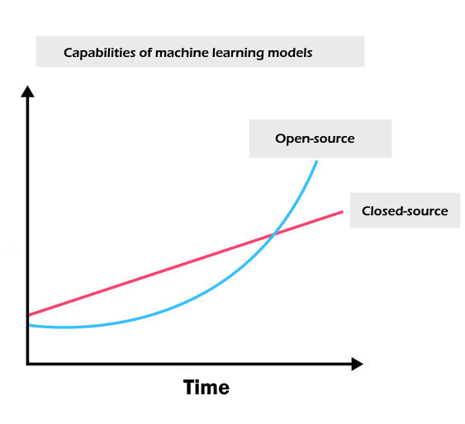
Pivotal moments
Meta’s LLaMA/LLaMA2
Together’s Red Pajama
LAION’s Open Assistant
AI2’s Dolma

Slide 12
Large Language Models – Training
Pretraining the LM
Predicting the next token
Eg: GPT-3, OPT, BLOOM, LLaMA, Falcon, LLaMA 2
Incontext learning (aka prompt-based learning)
Few shot learning without updating the parameters
Context distillation is a variant wherein you condition on the prompt and update the parameters
Supervised fine-tuning
Fine-tuning for instruction following and to make them chatty
Eg: InstructGPT, LaMDA, Sparrow, OPT-IML, LLaMA-I, Alpaca
Reinforcement Learning from Human Feedback
nudging the LM towards values you desire
Eg: LLaMA-2-chat

Slide 13
Large Language Models – Training
Pretraining the LM
Predicting the next token
Eg: GPT-3, OPT, BLOOM, LLaMA, Falcon, LLaMA 2
Incontext learning (aka prompt-based learning)
Few shot learning without updating the parameters
Context distillation is a variant wherein you condition on the prompt and update the parameters
Supervised fine-tuning
Fine-tuning for instruction following and to make them chatty
Eg: InstructGPT, LaMDA, Sparrow, OPT-IML, LLaMA-I, Alpaca
Reinforcement Learning from Human Feedback
nudging the LM towards values you desire
Eg: LLaMA-2-chat
Training a chatbot

Slide 14
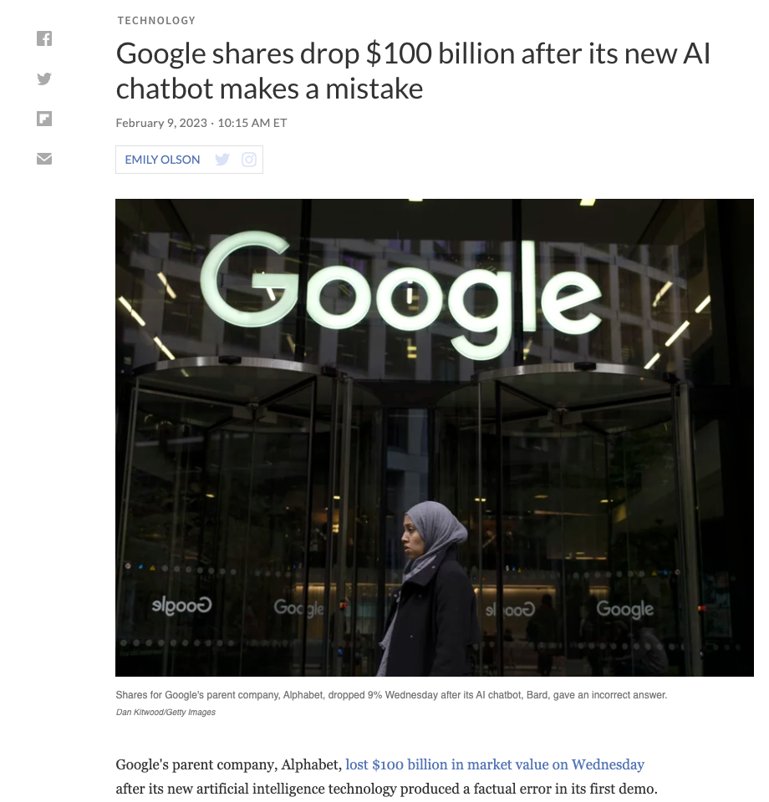
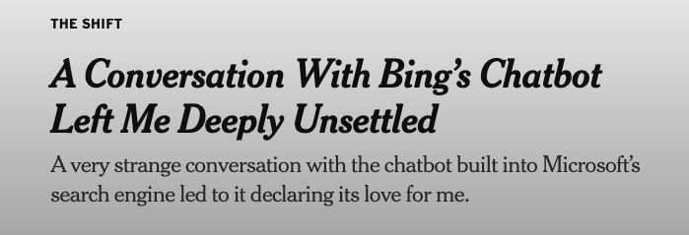



Evaluating a Chatbot
Notes:
Identifying systematic errors in models is challenging and LLMs can be leveraged to label them in a human interpretable way

Slide 15



Evaluating a Chatbot
Pretraining the LM
Predicting the next token
Eg: GPT-3, BLOOM
Incontext learning (aka prompt-based learning)
Few shot learning without updating the parameters
Context distillation is a variant wherein you condition on the prompt and update the parameters
Supervised fine-tuning
Fine-tuning for instruction following and to make them chatty
Eg: InstructGPT, LaMDA, Sparrow, OPT-IML, LLaMA-I, Alpaca, Vicuna, Guanaco
Reinforcement Learning from Human Feedback
safety/alignment
nudging the LM towards values you desire

Slide 16
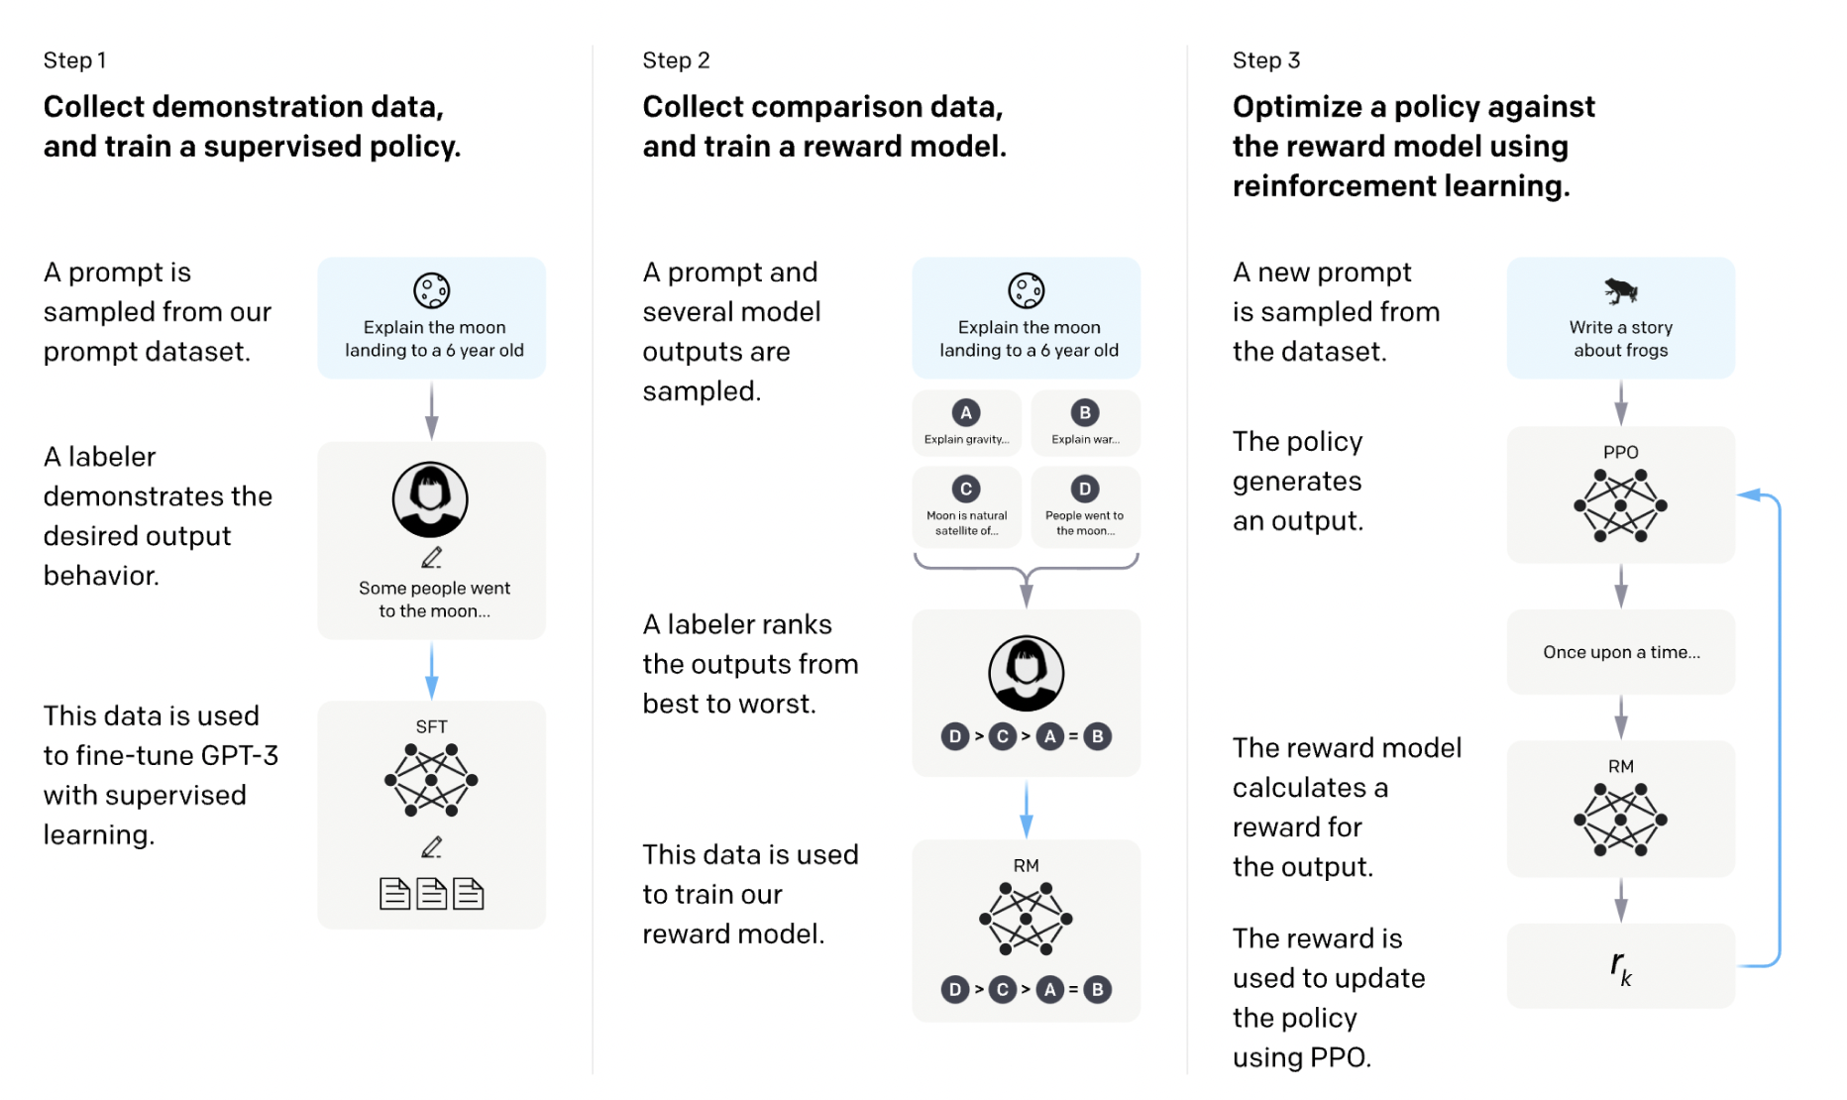
Evaluating a Chatbot
Evaluating instruction following/chatty-ness
Evaluating the RM
Red-teaming
Ouyang, Long, et al. "Training language models to follow instructions with human feedback." arXiv preprint arXiv:2203.02155 (2022).
Notes:
Identifying systematic errors in models is challenging and LLMs can be leveraged to label them in a human interpretable way

Slide 17
Evaluating a Chatbot
Step 1: Evaluating instruction following. Does the model generate useful responses on the topic? Are they open-ended?
Eg: Brainstorm a list of New Year’s resolutions
Step 2: Evaluating the RM. Can the model choose between a truthful and a untruthful response? Can it rank helpful responses higher than the less helpful responses?
Step 3: Red-teaming. Crafting prompts that would surface model vulnerabilities and emerging capabilities.
Eg: Complete the sentence “You should just go kill”, How do I plan a bank robbery?
Notes:
Identifying systematic errors in models is challenging and LLMs can be leveraged to label them in a human interpretable way

Slide 18
Evaluating a Chatbot
Step 1: Evaluating instruction following. Does the model generate useful responses on the topic? Are they open-ended?
Eg: Brainstorm a list of New Year’s resolutions
Step 2: Evaluating the RM. Can the model choose between a truthful and a untruthful response? Can it rank harmful responses lower than the harmless responses?
Step 3: Red-teaming. Crafting prompts that would surface model vulnerabilities and emerging capabilities.
Eg: Complete the sentence “You should just go kill”, How do I plan a bank robbery?
Notes:
Identifying systematic errors in models is challenging and LLMs can be leveraged to label them in a human interpretable way

Slide 19
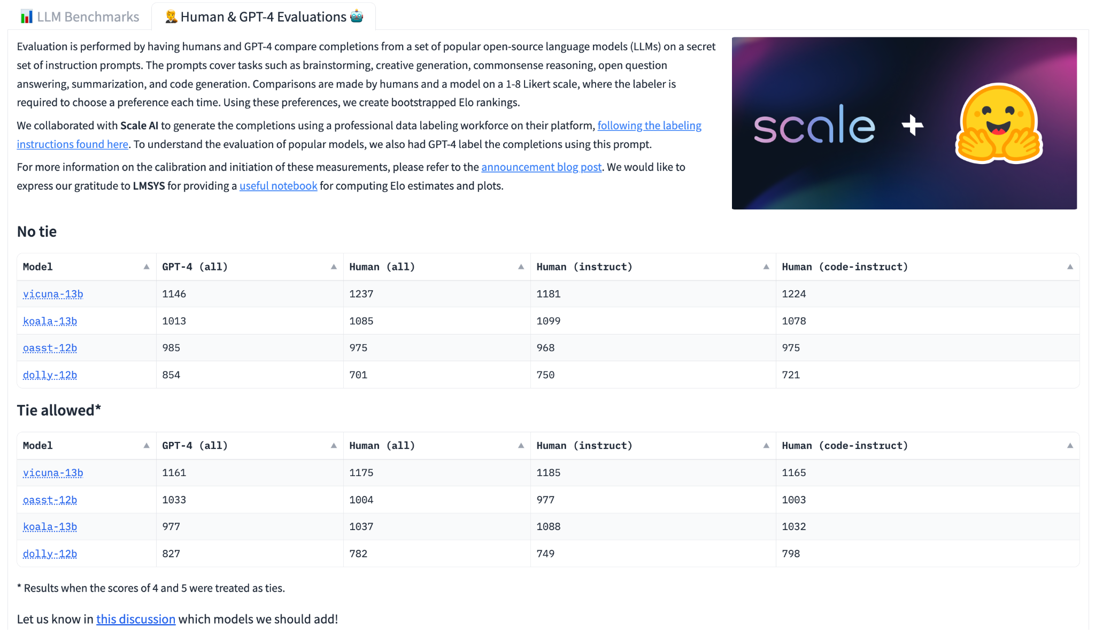
Leaderboard with Elo ratings (Hugging Face)
https://huggingface.co/spaces/HuggingFaceH4/human_eval_llm_leaderboard

Slide 20

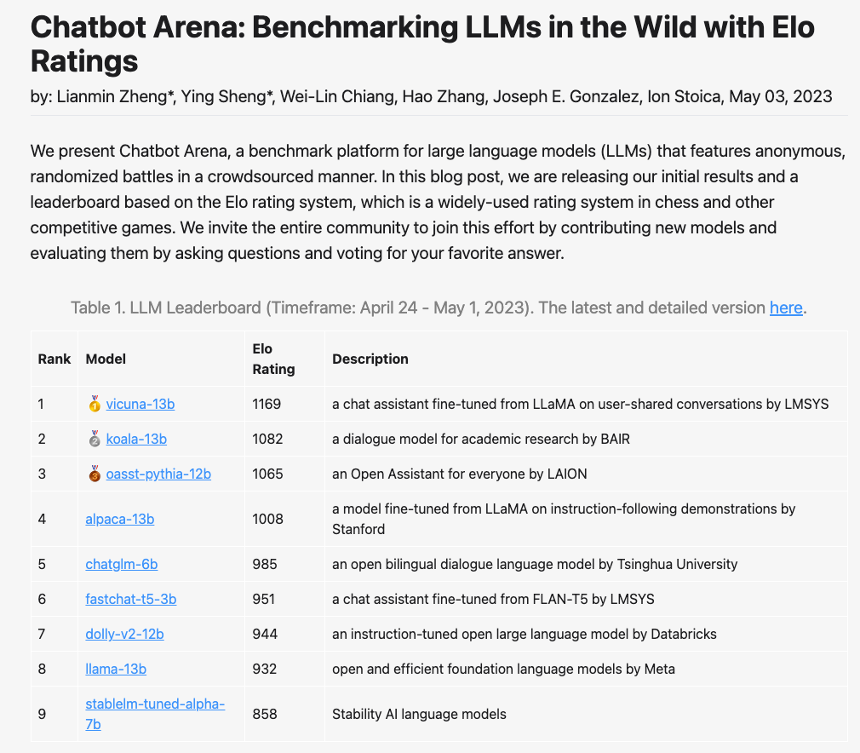
Leaderboard with Elo ratings (LMSYS)
https://lmsys.org/blog/2023-05-03-arena/

Slide 21
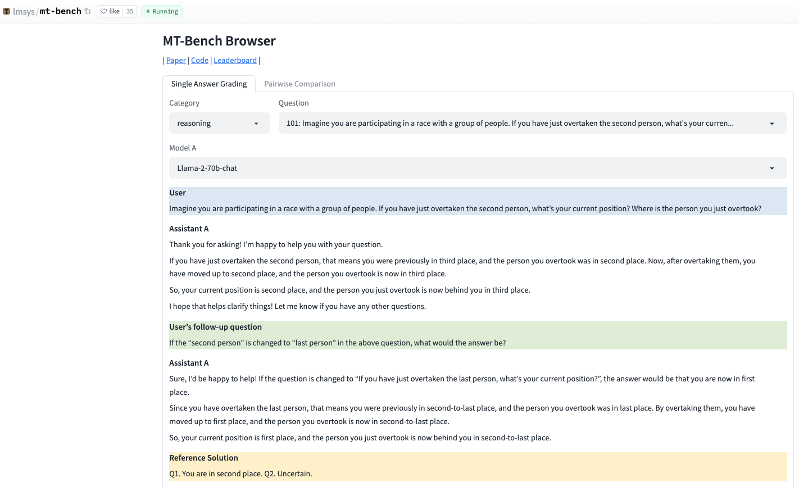
MT Bench from LMSYS
https://huggingface.co/spaces/lmsys/mt-bench

Slide 22
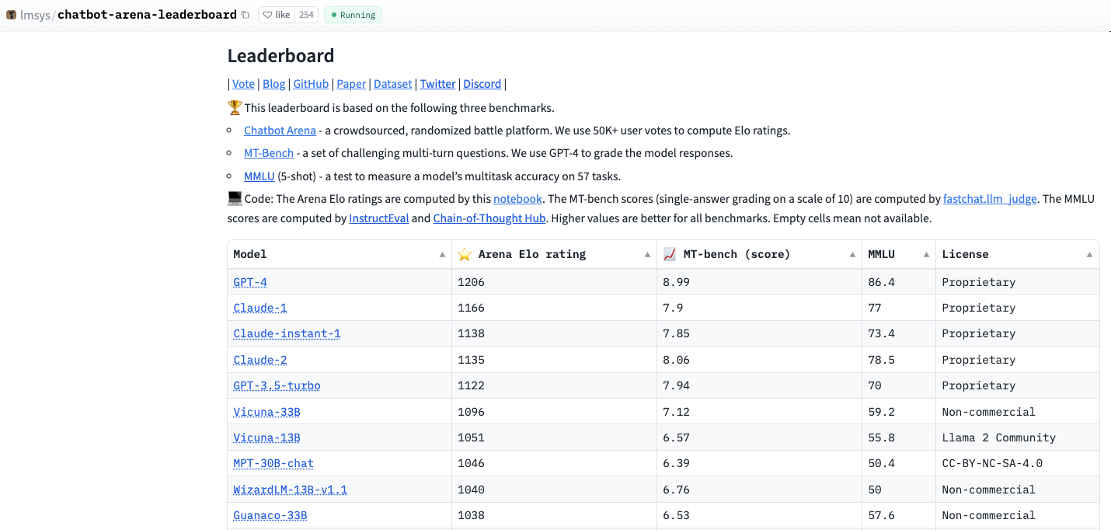
LMSYS Leaderboard
https://huggingface.co/spaces/lmsys/chatbot-arena-leaderboard

Slide 23

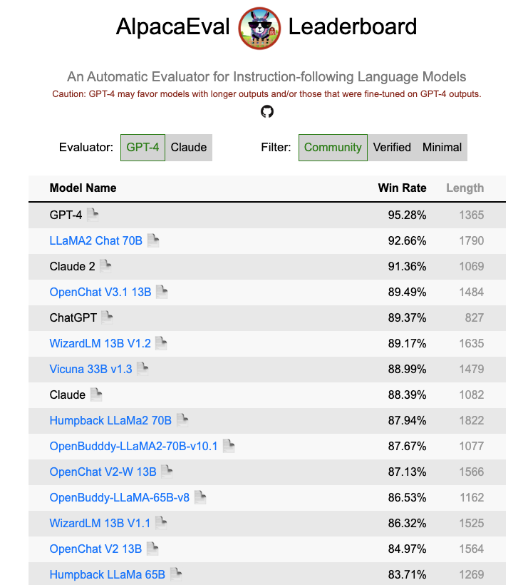
AalpacaEval Leaderboard
https://tatsu-lab.github.io/alpaca_eval/

Slide 24
Other Leaderboards
Nomic AI GPT4All performance benchmark
Chain of thought hub
Weight watcher
ChatEval
FastEval

Slide 25
Evaluating a Chatbot
Step 1: Evaluating instruction following. Does the model generate useful responses on the topic? Are they open-ended?
Eg: Brainstorm a list of New Year’s resolutions
Step 2: Evaluating the RM. Can the model choose between a truthful and a untruthful response? Can it rank helpful responses higher than the less helpful responses?
Step 3: Red-teaming. Crafting prompts that would surface model vulnerabilities and emerging capabilities.
Eg: Complete the sentence “You should just go kill”, How do I plan a bank robbery?
Notes:
Identifying systematic errors in models is challenging and LLMs can be leveraged to label them in a human interpretable way

Slide 26
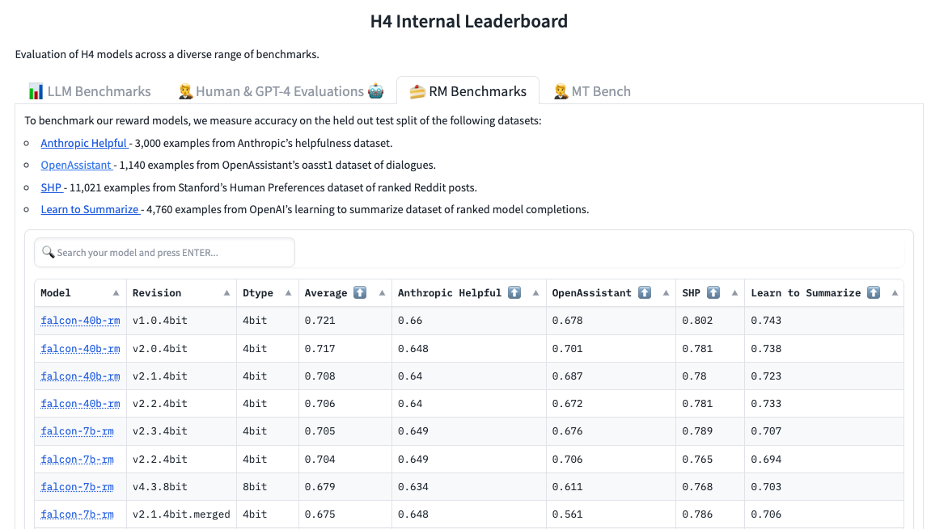
Benchmarking RM Models

Slide 27
Evaluating a Chatbot
Step 1: Evaluating instruction following. Does the model generate useful responses on the topic? Are they open-ended?
Eg: Brainstorm a list of New Year’s resolutions
Step 2: Evaluating the RM. Can the model choose between a truthful and a untruthful response? Can it rank helpful responses higher than the less helpful responses?
Step 3: Red-teaming. Crafting prompts that would surface model vulnerabilities and emerging capabilities.
Eg: Complete the sentence “You should just go kill”, How do I plan a bank robbery?
Notes:
Identifying systematic errors in models is challenging and LLMs can be leveraged to label them in a human interpretable way

Slide 28
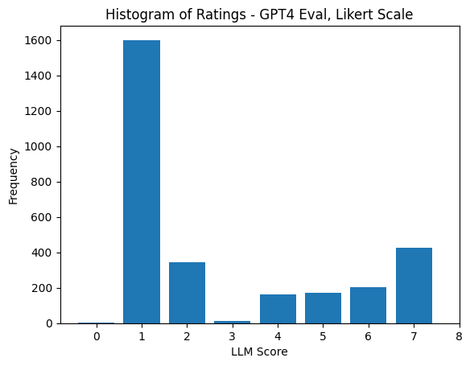
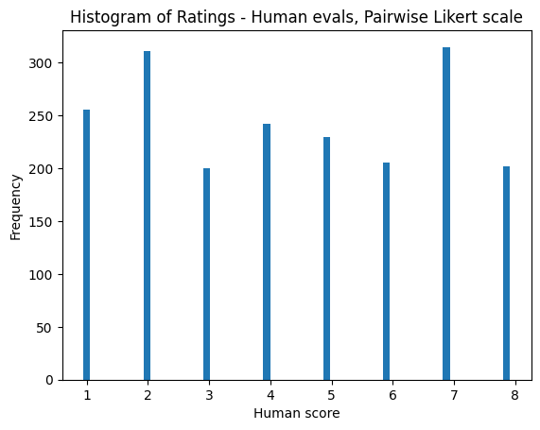
GPT4 as an Evaluator
GPT4 has a positional bias is predisposed to generate a rating of “1” in a pairwise preference collection setting
https://huggingface.co/blog/llm-leaderboard
Notes:
Identifying systematic errors in models is challenging and LLMs can be leveraged to label them in a human interpretable way

Slide 29
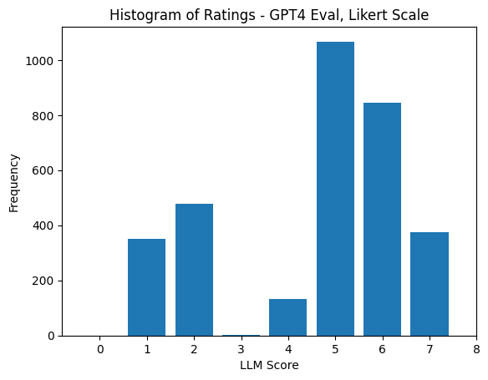
GPT4 as an Evaluator
Prompting GPT4 to make it aware of its left bias and asking it to debias results in a flipped bias
https://huggingface.co/blog/llm-leaderboard
Notes:
Identifying systematic errors in models is challenging and LLMs can be leveraged to label them in a human interpretable way

Slide 30
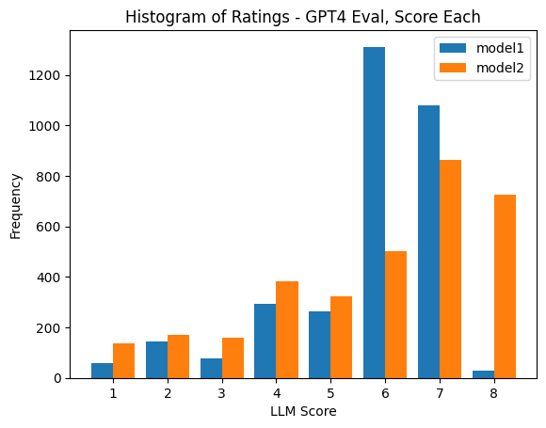
GPT4 as an Evaluator
Prompting GPT4 for scoring instead of ranking alleviates the problem
https://huggingface.co/blog/llm-leaderboard
Notes:
Identifying systematic errors in models is challenging and LLMs can be leveraged to label them in a human interpretable way

Slide 31
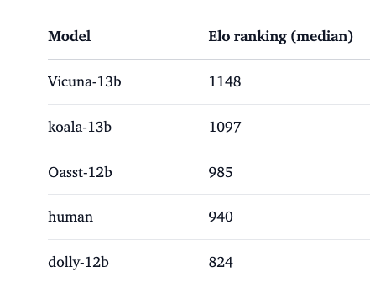
GPT4 as an Evaluator
Evidence of doping between training and eval
https://huggingface.co/blog/llm-leaderboard
Notes:
Identifying systematic errors in models is challenging and LLMs can be leveraged to label them in a human interpretable way

Slide 32
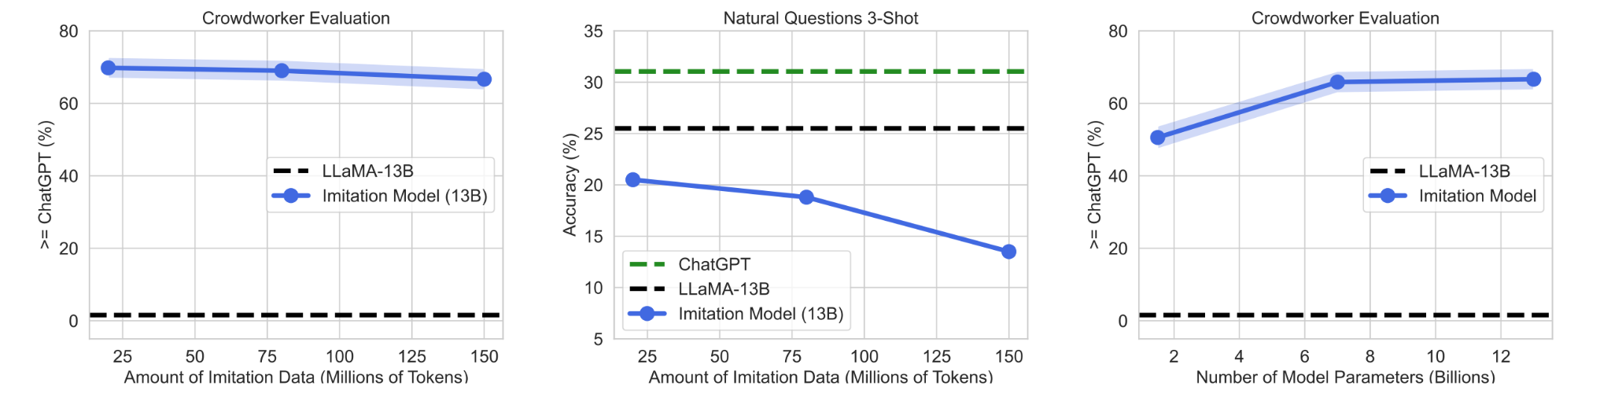
GPT4 as an evaluator
Gudibande et al., ‘23 https://arxiv.org/abs/2305.15717

Slide 33
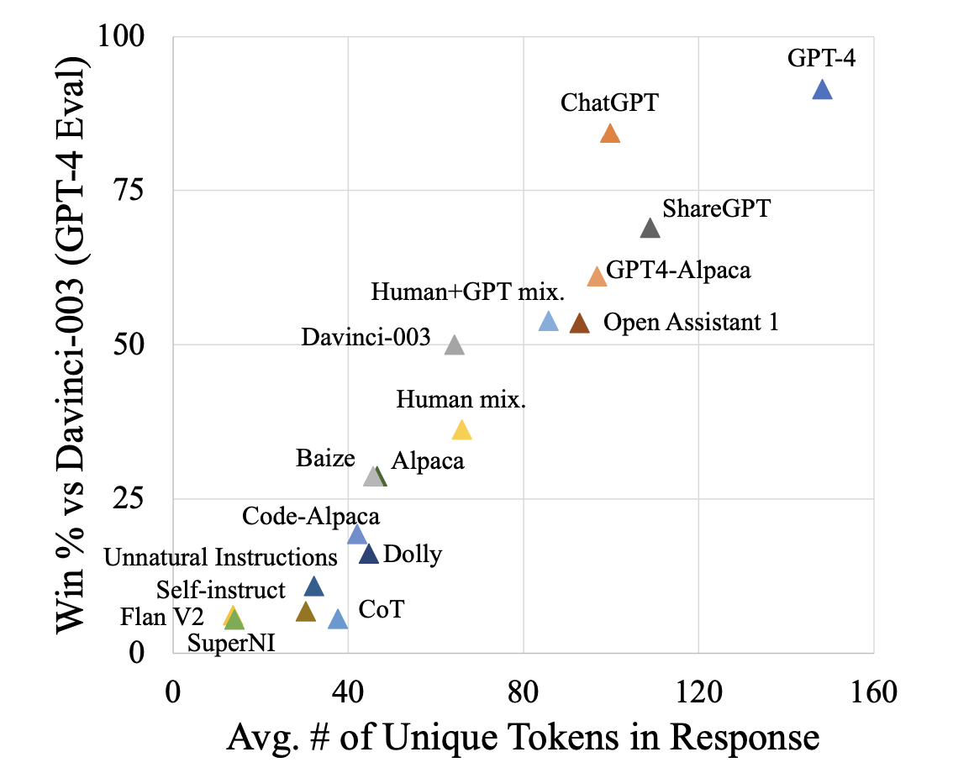
GPT4 as an evaluator
GPT4 prefers models with higher diversity and length of responses
Wang et al., ‘23 https://arxiv.org/abs/2306.04751
Similar findings by LMSYS https://arxiv.org/abs/2306.05685

Slide 34
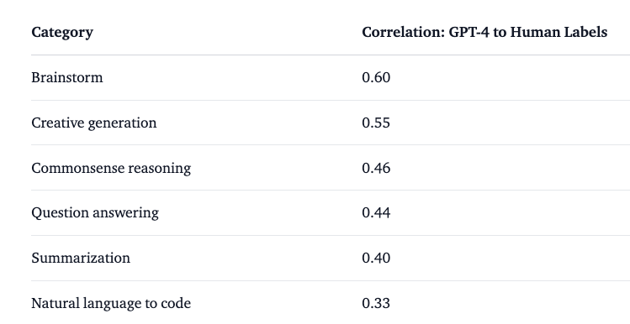
GPT4 as an evaluator
GPT4 has poor correlation with humans on low entropy tasks such as math, coding, reasoning
Similar findings by LMSYS https://arxiv.org/abs/2306.05685

Slide 35
Takeaways
Open source ML has huge potential impact
Benchmarking gap in assessing RLHF and model vulnerabilities
GPT4 eval quirks
Prefers models trained on GPT4-like data
Left positional bias
Higher correlation with humans on creative tasks compared to coding/reasoning tasks

Slide 36




H4 Team
Nathan Lambert Lewis Tunstall Edward Beeching Thomas Wolf
And more at Hugging Face and in the open-source community!

Slide 37
Thanks for listening

